Slide 1


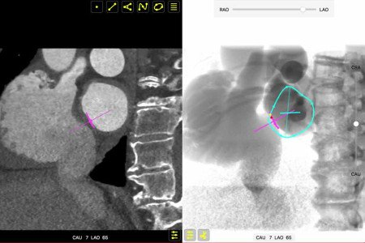

Fluoroscopic anatomy for the guidance of
transcatheter structural and coronary intervention (old)
Video 2
The video shows the relation between transseptal puncture height (infero-superior aspect) with mitral valve height (antero-posterior aspect). The atrial septum (pink circle) and mitral valve (turquoise circle) are sequentially depicted in bicaval (LAO-CAU), short axis of the aortic valve (RAO-CRA), and 4-chamber view (LAO-CRA). Despite two similarly appearing punctures on the bicaval view (i.e. superior punctures), the anterior (yellow dot) and posterior (red dot) punctures from the short axis perspective translate into low and high heights from the mitral valve plane.
Horacio Medina de Chazal, Ali Zgheib, Angelo Quagliana, Michael Chetrit, Jean Buithieu, Giuseppe Martucci, Marco
Spaziano, Ali Abualsaud, Ole de Baker, Laurence Campens, Pascal Theriault-Lauzier, Jeremy Ben-Shoshan, Nicolo Piazza
©2025 Europa Group - All rights reserved.

