Slide 1


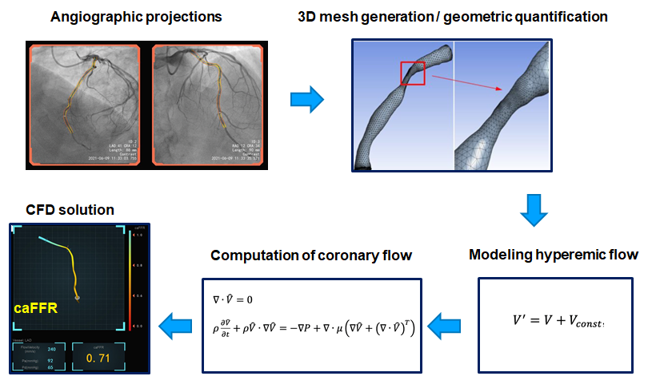

Functional coronary angiography to assess epicardial vessels and the microcirculation
Figure 1
Key steps in functional angiographic analysis, exemplified with caFFR.
Javier Escaned, Daniel Faria, Asad Shabbir, Lin Wang, Shengxian Tu, Nieves Gonzalo, Hernan Mejia-Renteria, Xu Bo
©2025 Europa Group - All rights reserved.

