Slide 1


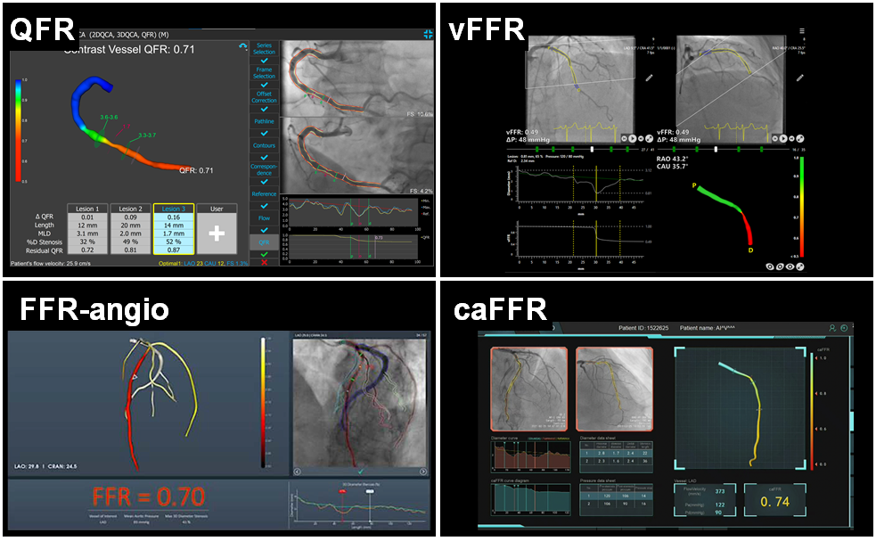

Functional coronary angiography to assess
epicardial vessels and the microcirculation
Figure 2
Commercially available functional coronary angiography systems: QFR, vFFR, FFR-angio and caFFR.
See text for details.
Javier Escaned, Daniel Faria, Asad Shabbir, Lin Wang, Shengxian Tu, Nieves Gonzalo, Hernan Mejia-Renteria, Xu Bo
©2025 Europa Group - All rights reserved.

