Slide 1


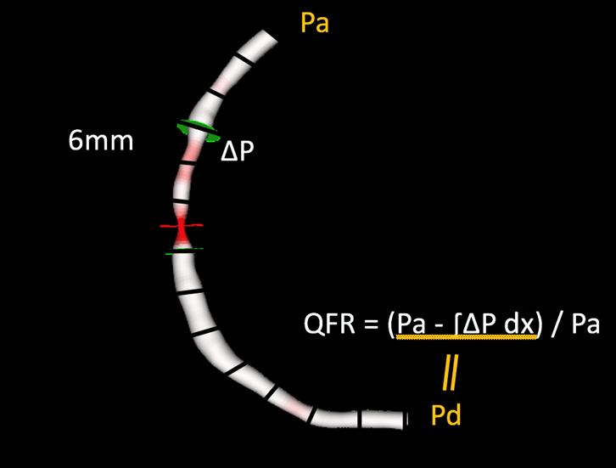

Functional coronary angiography to assess epicardial vessels and the microcirculation
Figure 3
Fundamentals of the calculation of quantitative flow ratio (QFR). Once a three-dimensional geometric mesh is derived from 2 orthogonal angiographic projections, partial pressure drops are calculated at consecutive 6 mm segments according to derived friction and turbulence pressure coefficients, and subsequently integrated into the entire analysed segment.
Javier Escaned, Daniel Faria, Asad Shabbir, Lin Wang, Shengxian Tu, Nieves Gonzalo, Hernan Mejia-Renteria, Xu Bo
©2025 Europa Group - All rights reserved.

