Slide 1


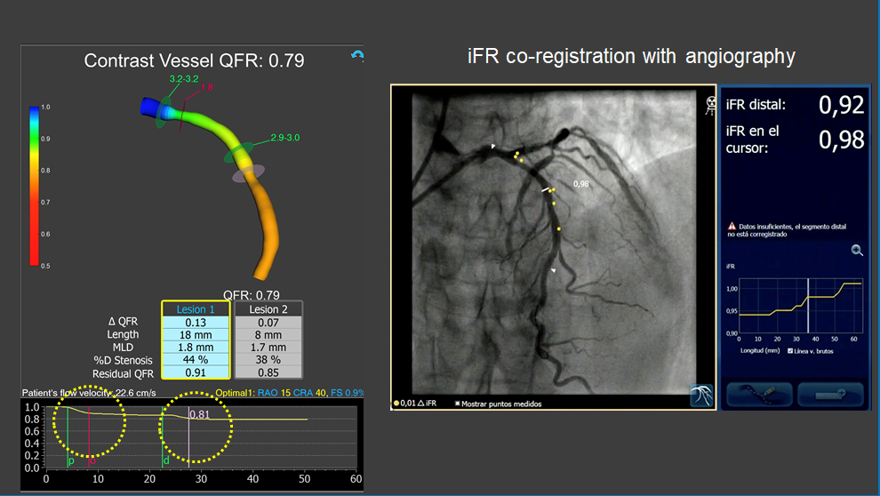

Functional coronary angiography to assess epicardial vessels and the microcirculation
Figure 4
Assessment of intermediate LAD stenosis using QFR. The analysis revealed two separate stenoses in proximal and mid LAD segments with mild-moderate flow-limiting effect (QFR = 0.79). iFR coregistration confirmed non-significant flow-limiting effect of coronary stenosis. Note the similarity between longitudinal vessel analysis obtained with QFR and intracororonary iFR pullback.
Javier Escaned, Daniel Faria, Asad Shabbir, Lin Wang, Shengxian Tu, Nieves Gonzalo, Hernan Mejia-Renteria, Xu Bo
©2025 Europa Group - All rights reserved.

