Slide 1


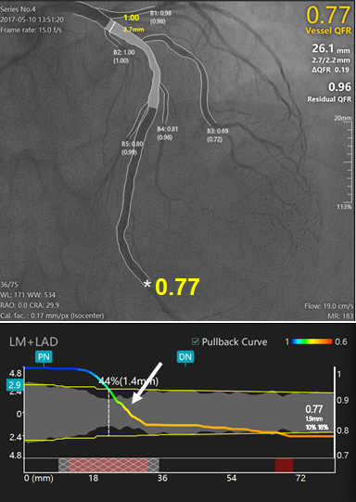

Functional coronary angiography to assess
epicardial vessels and the microcirculation
Figure 5
New generation Murray law-based QFR (µQFR) system powered with artificial intelligence algorithms.
Upper panel shows a diffuse intermediate lesion at the proximal to LAD. The lumen contours of LAD and its side branches were automatically delineated and superimposed on the angiographic images. The computed μQFR at the asterisk position was 0.77 while the wire based FFR was 0.78. Lower panel shows the co-registration between lumen size and μQFR pullback at every position along the LAD. The intermediate lesion correspond to a significant pressure drop in the μQFR pullbacks (white arrows).
Javier Escaned, Daniel Faria, Asad Shabbir, Lin Wang, Shengxian Tu, Nieves Gonzalo, Hernan Mejia-Renteria, Xu Bo
©2025 Europa Group - All rights reserved.

