Slide 1


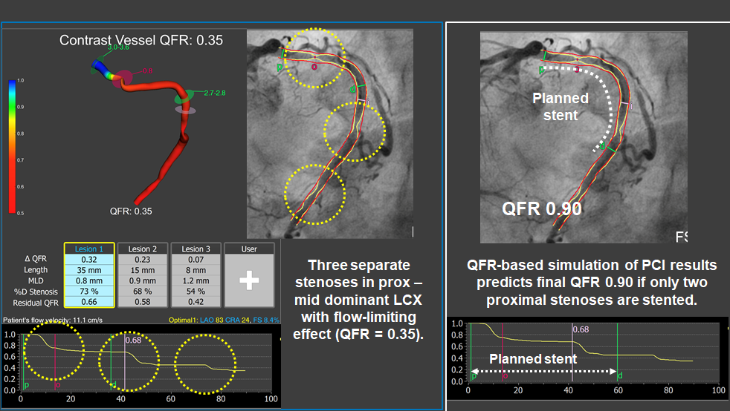

Functional coronary angiography to assess epicardial vessels and the microcirculation
Figure 6
Simulation of functional results of PCI using QFR. A dominant left circumflex artery presented three separate stenoses with a combined flow-limiting effect (QFR = 0.35). By calculating the residual QFR value, it was possible to predict that the more distal stenoses would have no significant functional impact if the two proximal ones were treated (estimated QFR 0.90). After following that revascularisation plan, leaning un-stented the more distal stenosis, final iFR in the LCX vessel was 0.93.
Javier Escaned, Daniel Faria, Asad Shabbir, Lin Wang, Shengxian Tu, Nieves Gonzalo, Hernan Mejia-Renteria, Xu Bo
©2025 Europa Group - All rights reserved.

