Slide 1


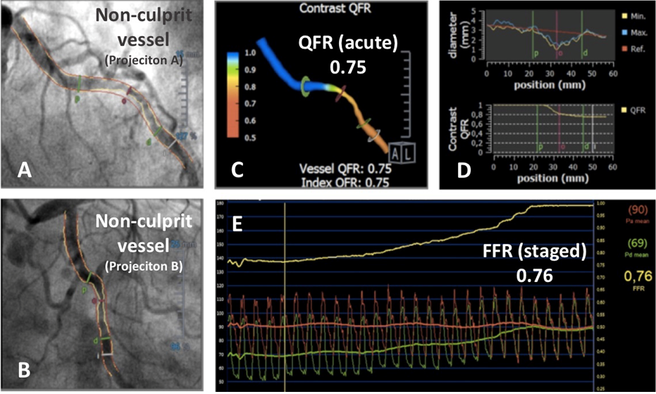

Functional coronary angiography to assess epicardial vessels and the microcirculation
Figure 8
Use of QFR to analyse a non-culprit stenosis in a patient presenting with ST elevation myocardial infarction (STEMI) and multivessel disease. A non-culprit lesion in circumflex artery assessed by QFR using the angiogram obtained over the acute phase of STEMI (A-B). A three-dimensional reconstruction of the vessel with colour mapping of the pressure drop (C). Longitudinal vessel analysis with QFR revealed the presence of a flow-limiting stenosis (D). An FFR pullback performed five days later in the same vessel over a staged angiogram confirmed QFR findings made at the acute STEMI phase (E).
Javier Escaned, Daniel Faria, Asad Shabbir, Lin Wang, Shengxian Tu, Nieves Gonzalo, Hernan Mejia-Renteria, Xu Bo
©2025 Europa Group - All rights reserved.

