Slide 1


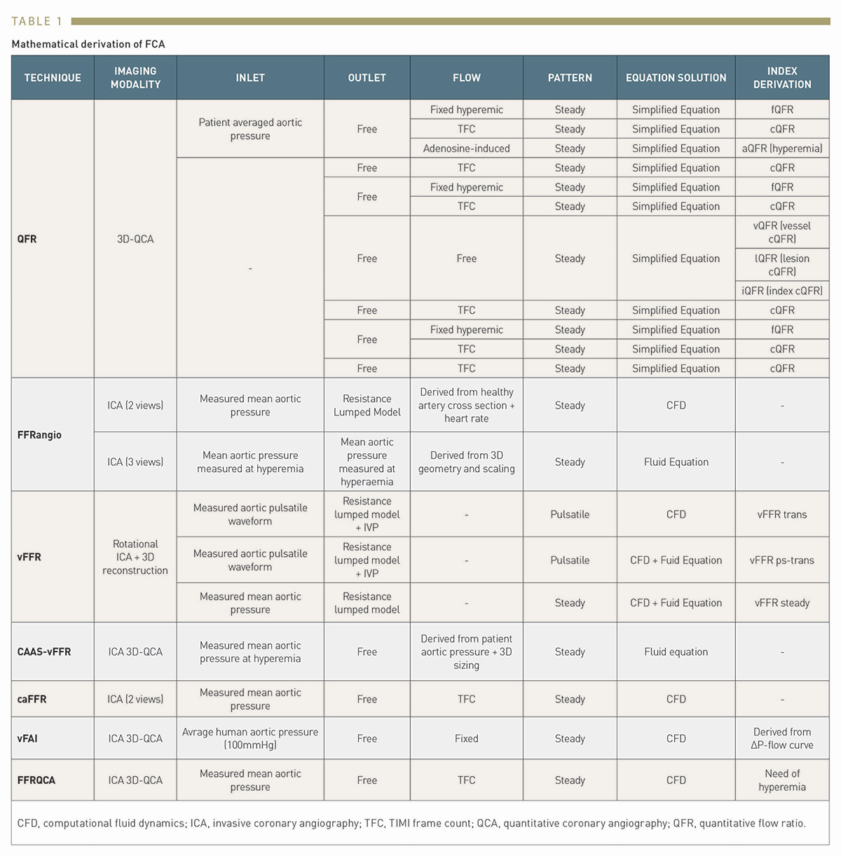

Functional coronary angiography to assess epicardial vessels and the microcirculation
Table 1
Javier Escaned, Daniel Faria, Asad Shabbir, Lin Wang, Shengxian Tu, Nieves Gonzalo, Hernan Mejia-Renteria, Xu Bo
©2025 Europa Group - All rights reserved.

