Slide 1


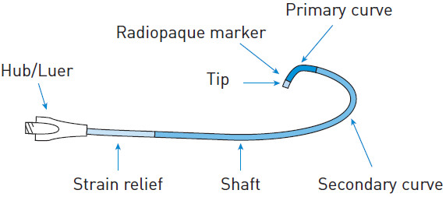

Guide catheters and wires
Figure 1
Components of a catheterHub – “handle” configuration.Shaft – polyurethane or polyethylene with wire/nylon braiding to provide support and torque transmission. Catheter gradually softens from proximal to distal tip.Tip – soft and atraumatic; of varying shape and length; radiopaque marker.(courtesy of Medtronic)
Soo-Teik Lim, Tian-Hai Koh
©2025 Europa Group - All rights reserved.

