Slide 1


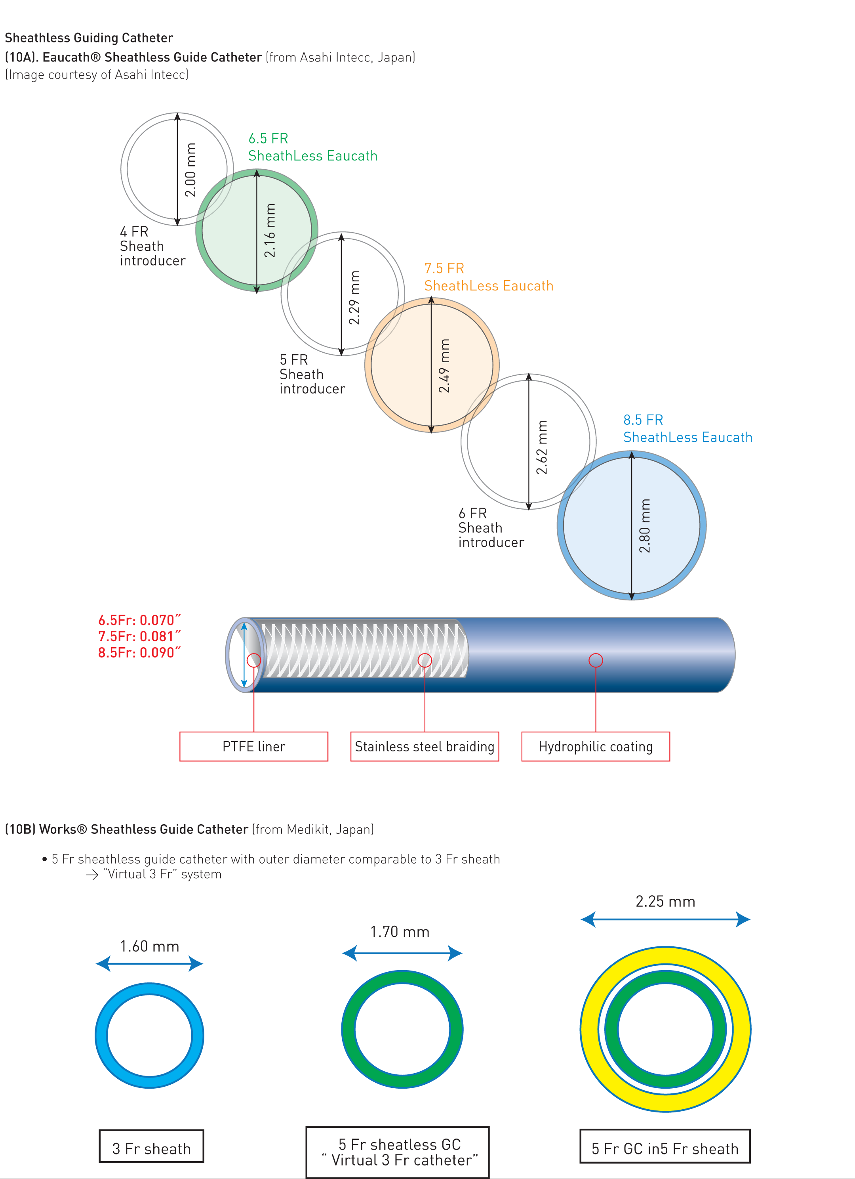

Guide catheters and wires
Figure 10
Sheathless Guiding Catheter
(10A). Eaucath® Sheathless Guide Catheter (from Asahi Intecc, Japan)(Image courtesy of Asahi Intecc)(10B) Meito Masamune Sheathless Guide Catheter (from Medikit, Japan)
5 Fr sheathless guide catheter with outer diameter comparable to 3 Fr sheath
“Virtual 3 Fr” system
Soo-Teik Lim, Tian-Hai Koh
©2025 Europa Group - All rights reserved.

