Slide 1


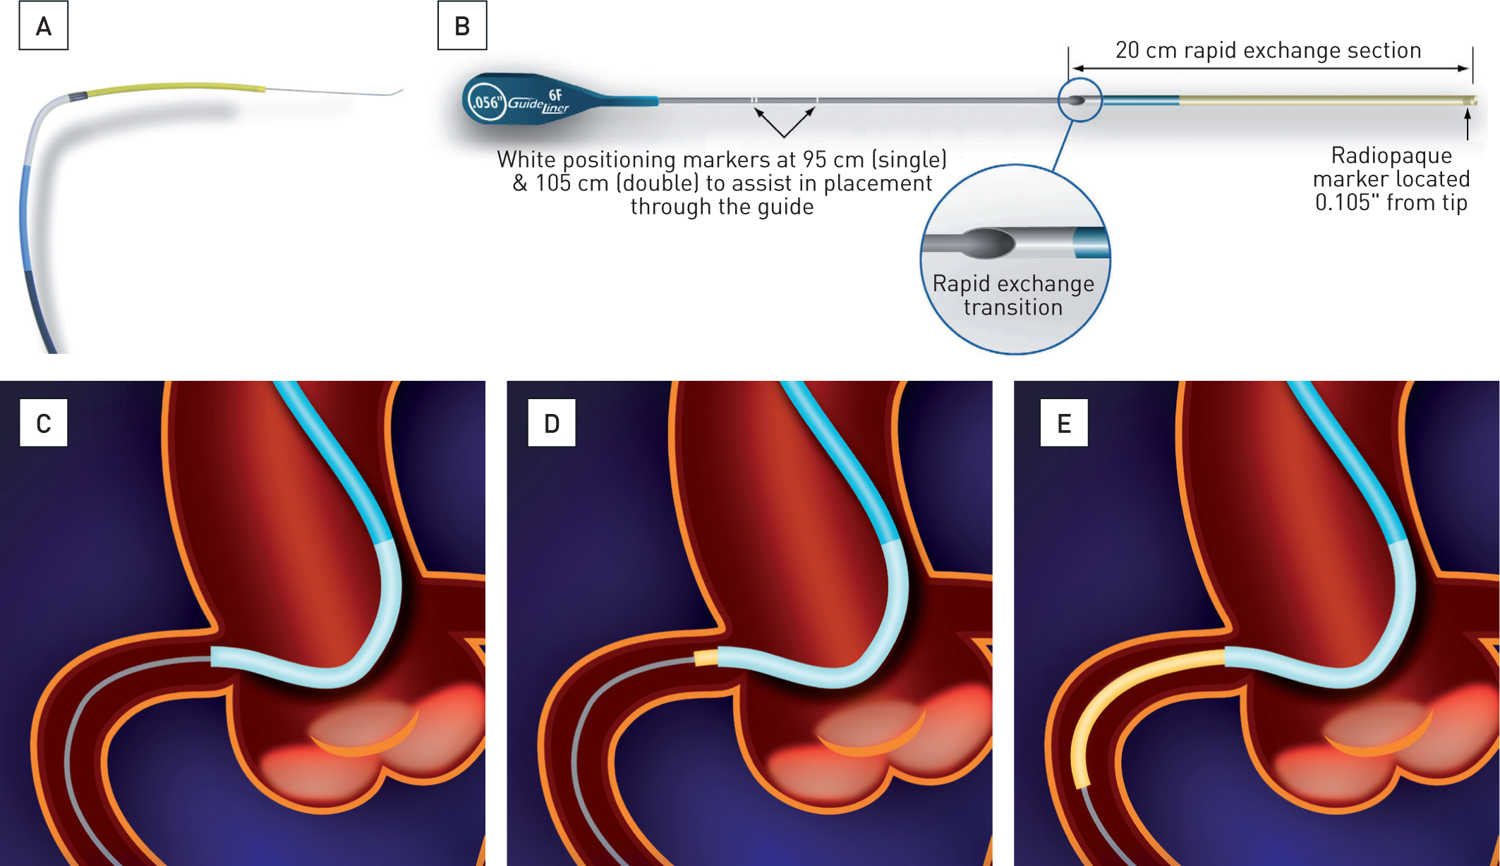

Guide catheters and wires
Figure 11
Mother-and-child technique
A - B Example of a double coaxial guide system (courtesy of Vascular Solutions Inc., Minneapolis, MN, USA) Upper panel: inner coaxial catheter Lower panel: ''mother'' guide catheter (blue) with fully extended inner coaxial catheter extension (yellow) Principle of the ''mother''-in-''child'' technique
C - Guide catheter engaged in the right coronary artery
D - Initial portion of an inner coaxial system protruding from the guide catheter
E - Fully extended segment of inner coaxial catheter
Soo-Teik Lim, Tian-Hai Koh
©2025 Europa Group - All rights reserved.

