Slide 1


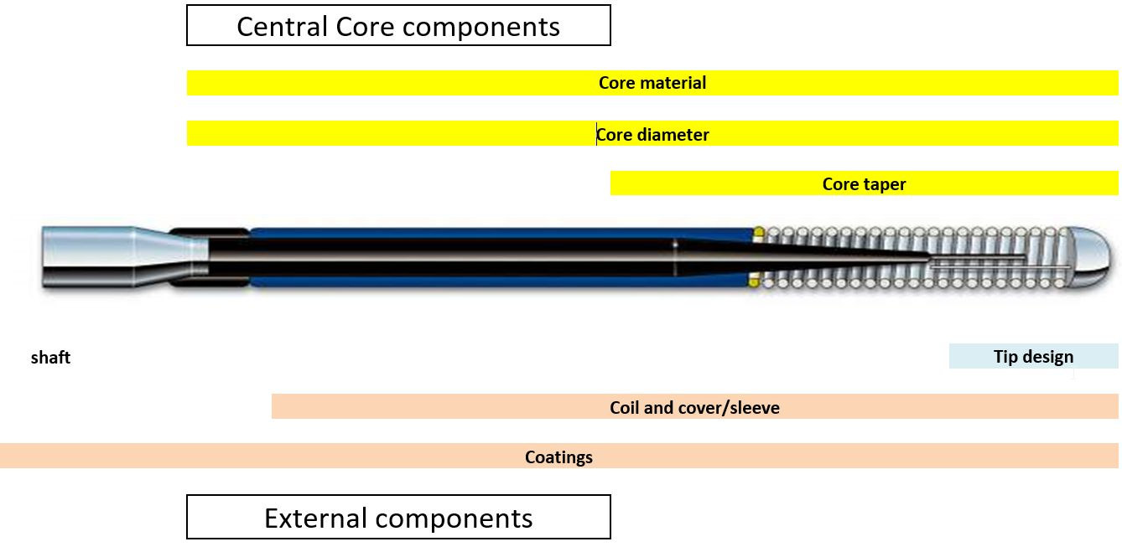

Guide catheters and wires
Figure 12
Components / building blocks of a guidewire
Soo-Teik Lim, Tian-Hai Koh
©2025 Europa Group - All rights reserved.

