Slide 1


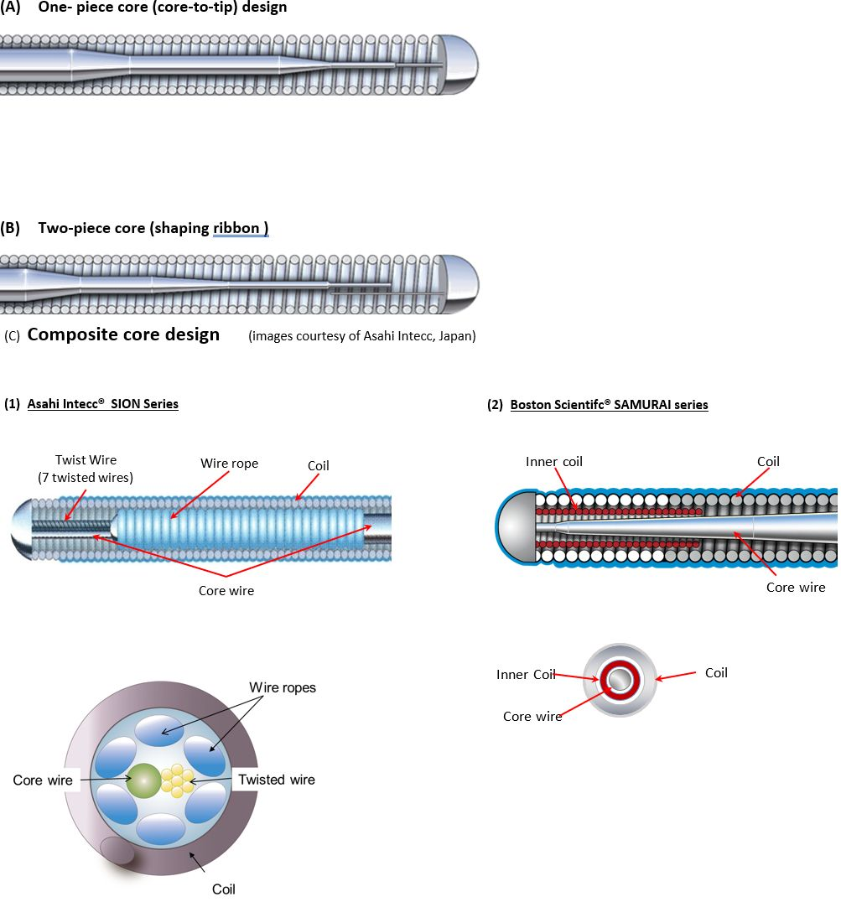

Guide catheters and wires
Figure 15
Guidewire tip design/style
Soo-Teik Lim, Tian-Hai Koh
©2025 Europa Group - All rights reserved.

