Slide 1


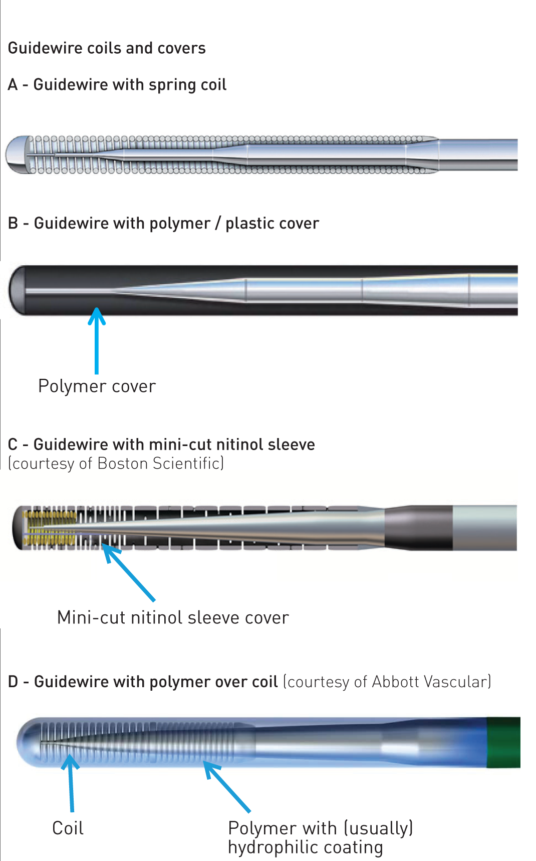

Guide catheters and wires
Figure 16
Guide coils and covers
Soo-Teik Lim, Tian-Hai Koh
©2025 Europa Group - All rights reserved.

