Slide 1


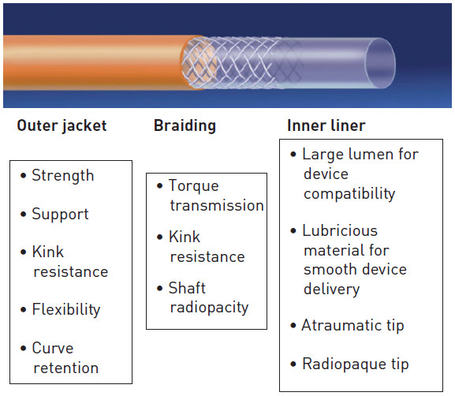

Guide catheters and wires
Figure 2
Design features of a guide catheter[image courtesy of Medtronic]
Soo-Teik Lim, Tian-Hai Koh
©2025 Europa Group - All rights reserved.

