Slide 1


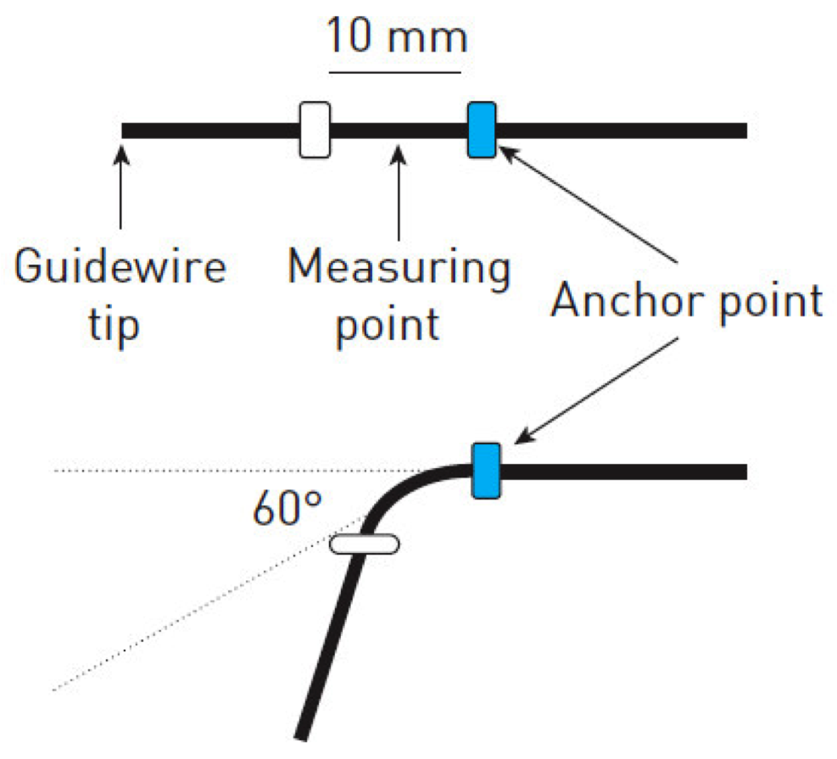
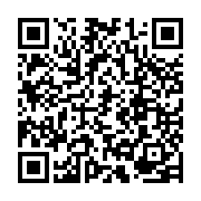
Guide catheters and wires
Figure 22
Guidewire support performanceTest method: measure the force required for 60° bending at different distances from the tip
Soo-Teik Lim, Tian-Hai Koh
©2025 Europa Group - All rights reserved.

