Slide 1


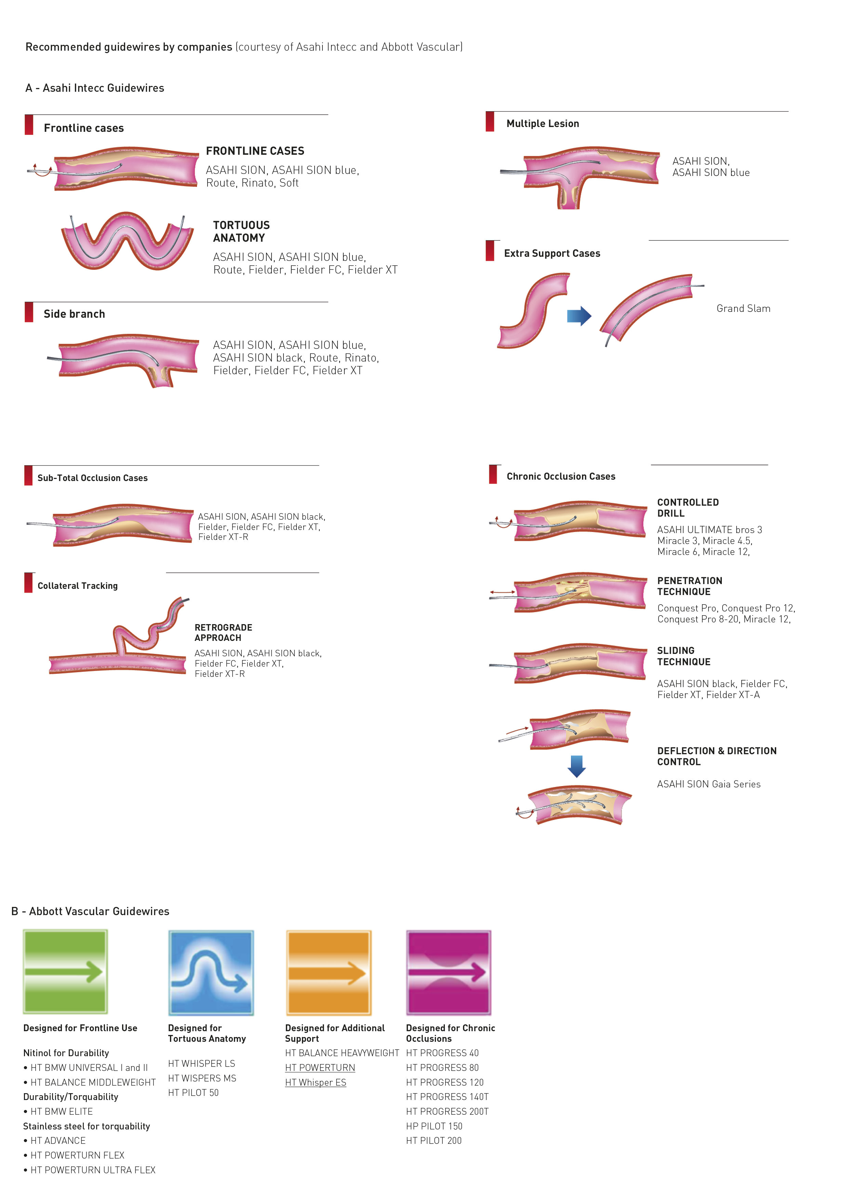

Guide catheters and wires
Figure 25
Recommended guidewires by companies(courtesy of Asahi Intecc and Abbott Vascular)
Soo-Teik Lim, Tian-Hai Koh
©2025 Europa Group - All rights reserved.

