Slide 1


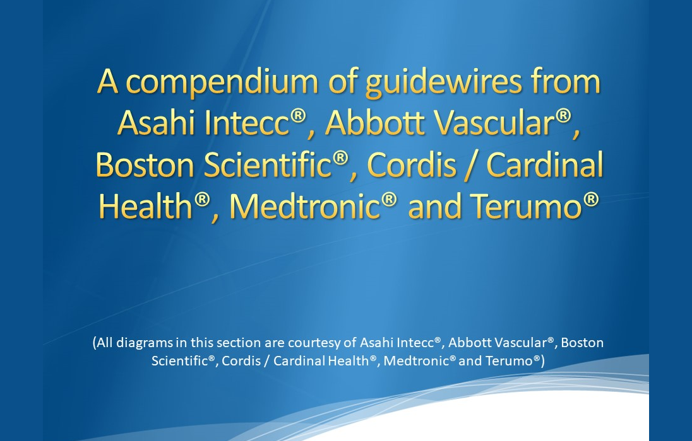

Guide catheters and wires
Figure 26
Diagrams courtesy of Asahi Intecc® ; Abbott Vascular®, Boston Scientific®, Medtronic®, Terumo®
Soo-Teik Lim, Tian-Hai Koh
©2025 Europa Group - All rights reserved.

