Slide 1


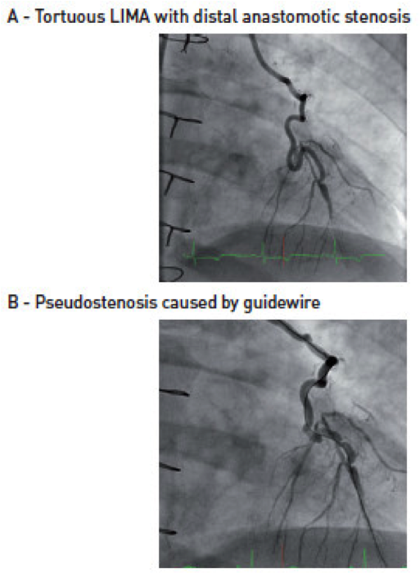

Guide catheters and wires
Figure 27
Pseudostenosis caused by wire
Soo-Teik Lim, Tian-Hai Koh
©2025 Europa Group - All rights reserved.

