Slide 1


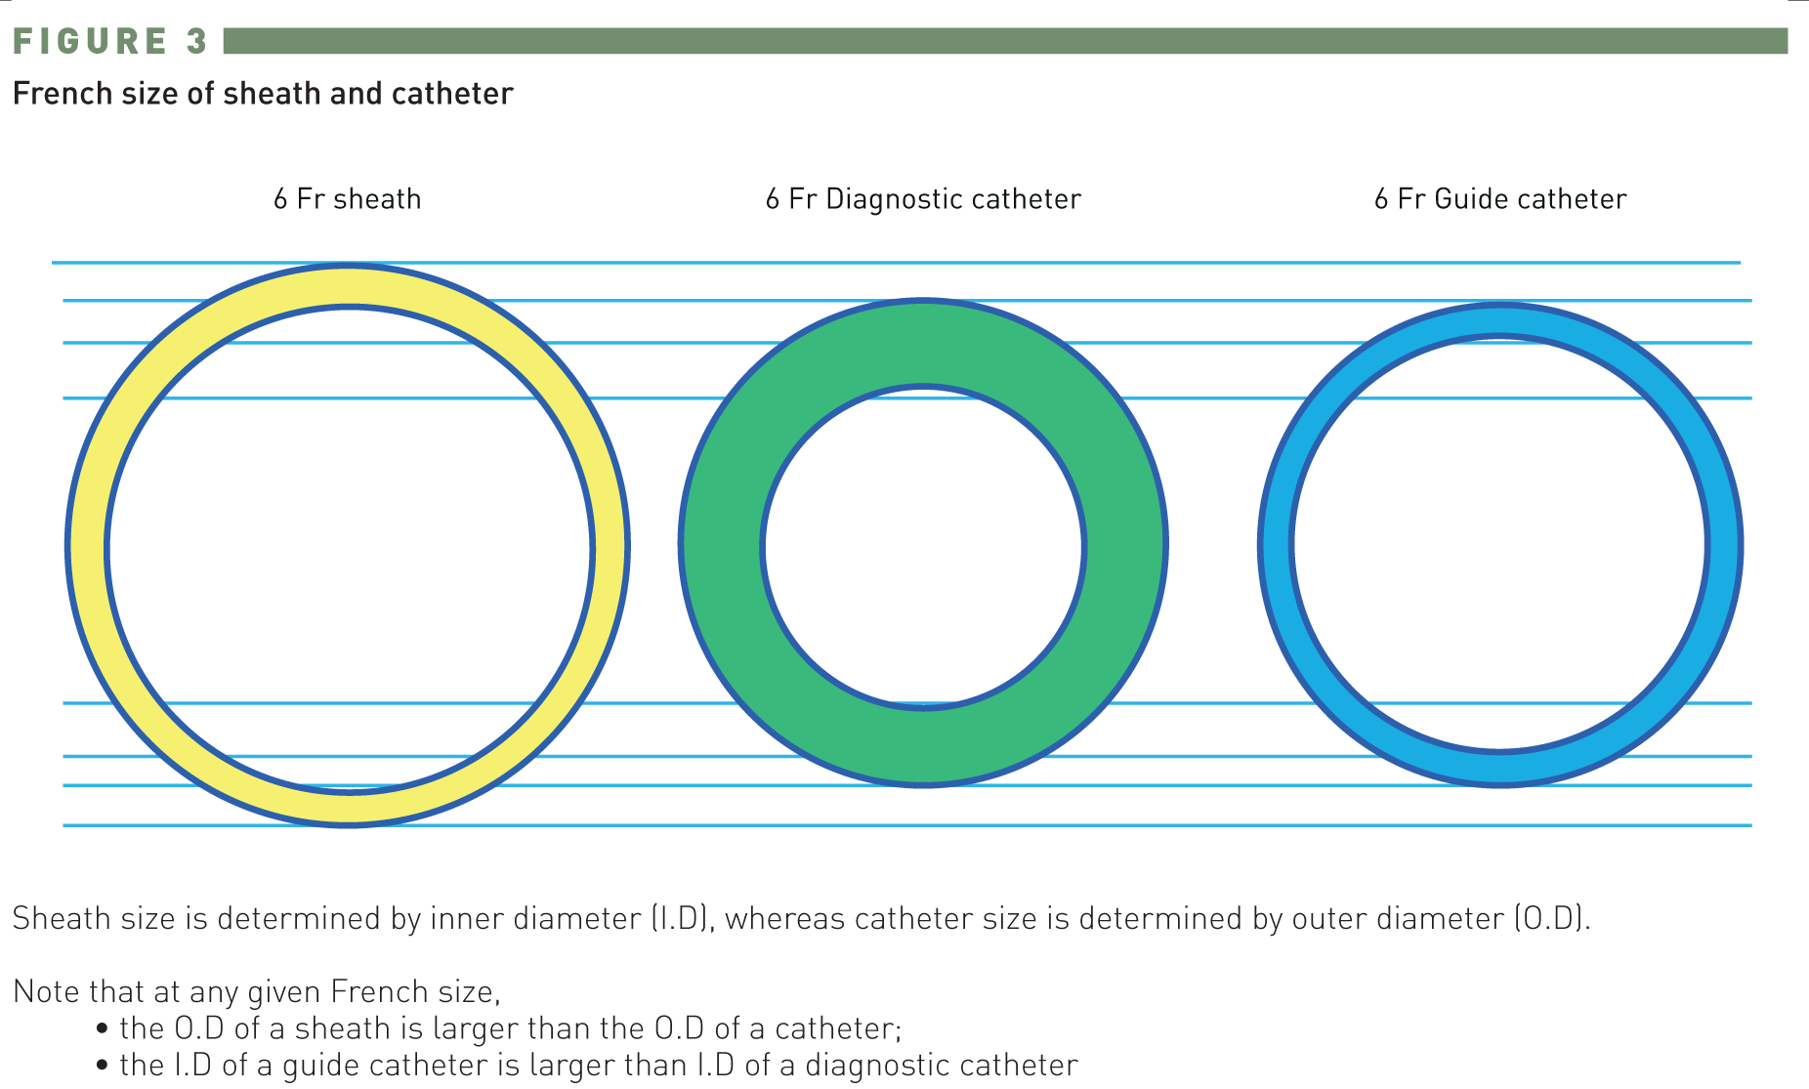

Guide catheters and wires
Figure 3
French size of sheath and catheter
Soo-Teik Lim, Tian-Hai Koh
©2025 Europa Group - All rights reserved.

