Slide 1


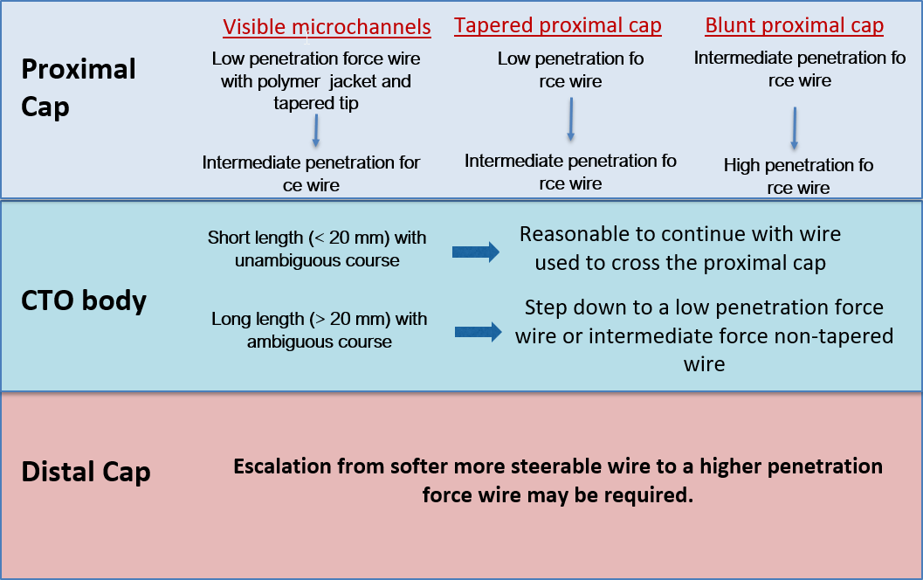

Guide catheters and wires
Figure 31
Guidewire selection for antegrade wire based strategy for CTO PCI
Soo-Teik Lim, Tian-Hai Koh
©2025 Europa Group - All rights reserved.

