Slide 1


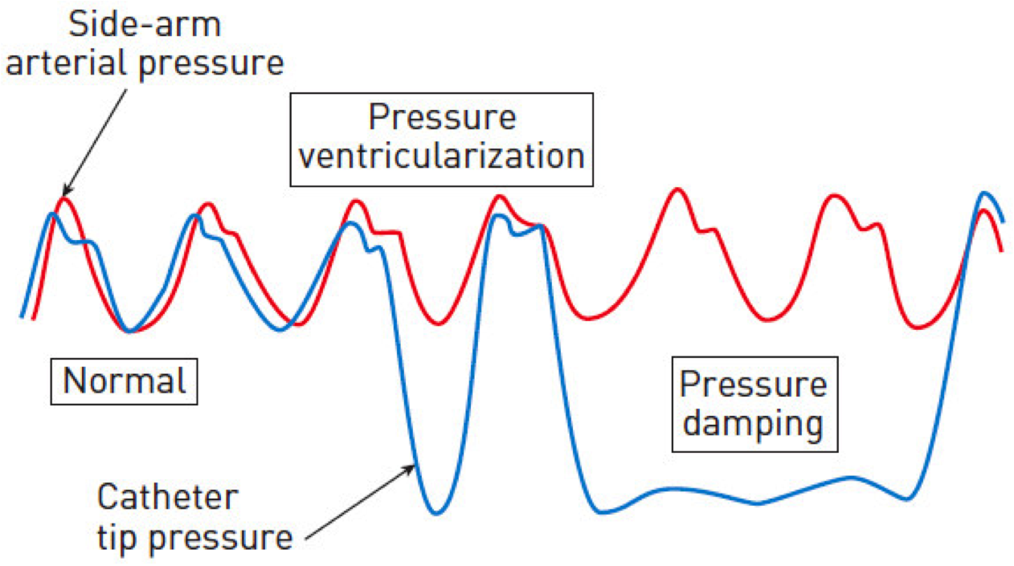

Guide catheters and wires
Figure 4
Pressure ventricularisation and pressure damping
Soo-Teik Lim, Tian-Hai Koh
©2025 Europa Group - All rights reserved.

