Slide 1


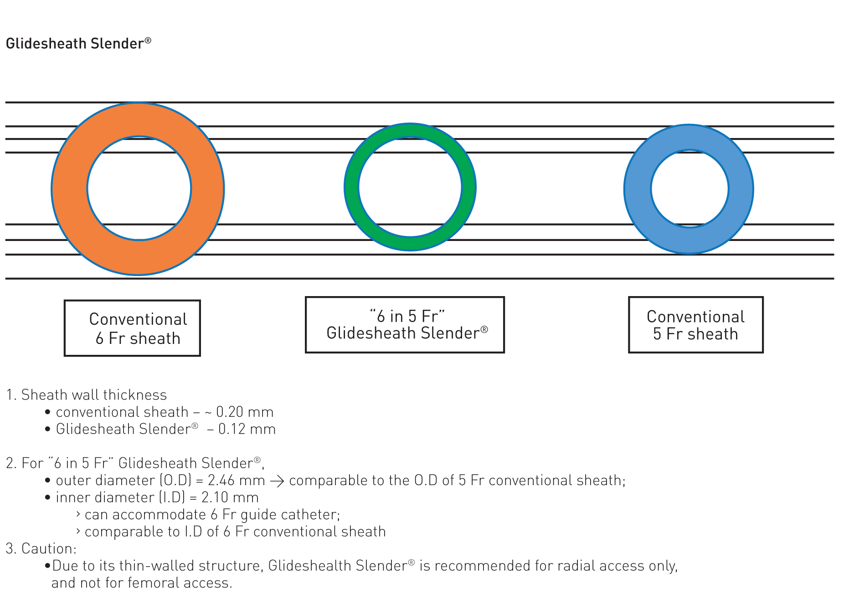

Guide catheters and wires
Figure 9
Asahi Intecc SheathLess Eaucath guide catheter(image courtesy of Asahi Intecc)
Soo-Teik Lim, Tian-Hai Koh
©2025 Europa Group - All rights reserved.

