Slide 1


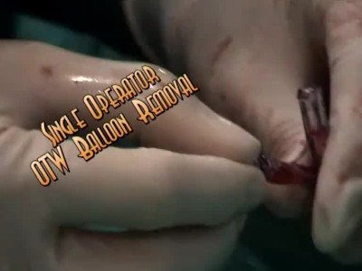

Guide catheters and wires
MOVING IMAGE 1
Removing OTW balloon using saline flushing method”.
Soo-Teik Lim, Tian-Hai Koh
©2025 Europa Group - All rights reserved.

