Slide 1


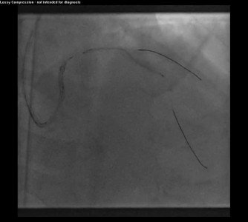

Guide catheters and wires
MOVING IMAGE 10
Unable to advance the stent across the entire length of calcified LAD stenosis, even though the LAD stenosis had been predilated multiple times.
Soo-Teik Lim, Tian-Hai Koh
©2025 Europa Group - All rights reserved.

