Slide 1


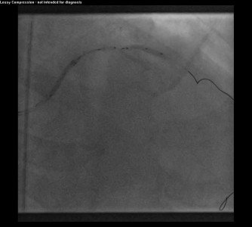

Guide catheters and wires
MOVING IMAGE 11
A 2.5 mm balloon was inflated in D1. This served as ‘anchoring balloon’ to provide enhanced support for the advancement of the 3.0 x 38mm DES into the distal part of mid LAD.
Soo-Teik Lim, Tian-Hai Koh
©2025 Europa Group - All rights reserved.

