Slide 1


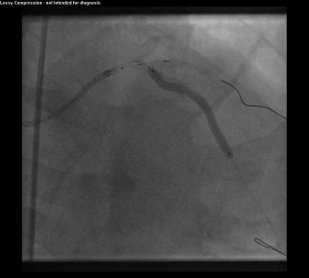

Guide catheters and wires
MOVING IMAGE 12
Deployment of 3.0 x 38 mm DES in mid LAD.
Soo-Teik Lim, Tian-Hai Koh
©2025 Europa Group - All rights reserved.

