Slide 1


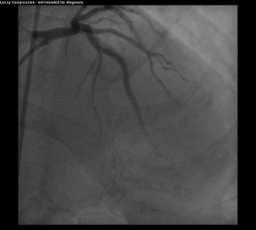

Guide catheters and wires
MOVING IMAGE 15
Final result. RAO cranial view.
Soo-Teik Lim, Tian-Hai Koh
©2025 Europa Group - All rights reserved.

