Slide 1


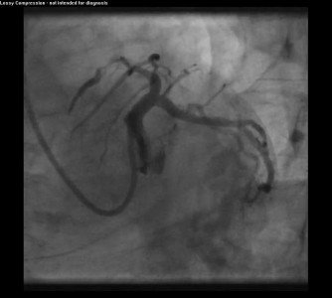

Guide catheters and wires
MOVING IMAGE 4
LCA in LAO caudal view.
Soo-Teik Lim, Tian-Hai Koh
©2025 Europa Group - All rights reserved.

