Slide 1


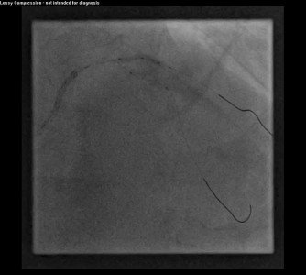

Guide catheters and wires
MOVING IMAGE 7
Balloon dilatation of first diagonal (D1) lesion.
Soo-Teik Lim, Tian-Hai Koh
©2025 Europa Group - All rights reserved.

