Slide 1


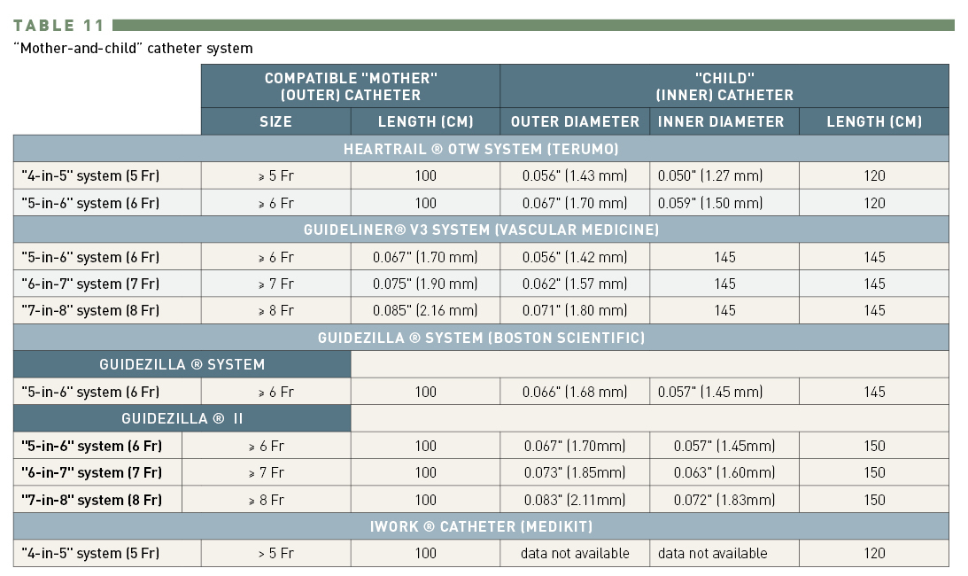

Guide catheters and wires
Table 11
Dimensions in “mother-and-child” catheter system
Soo-Teik Lim, Tian-Hai Koh
©2025 Europa Group - All rights reserved.

