Slide 1


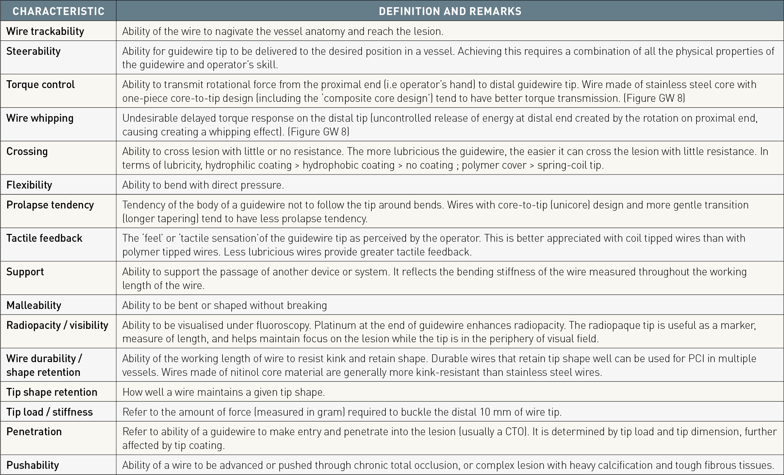

Guide catheters and wires
Table 13
Common terms used to describe guidewire main characterisn/a = not available
Soo-Teik Lim, Tian-Hai Koh
©2025 Europa Group - All rights reserved.

