Slide 1


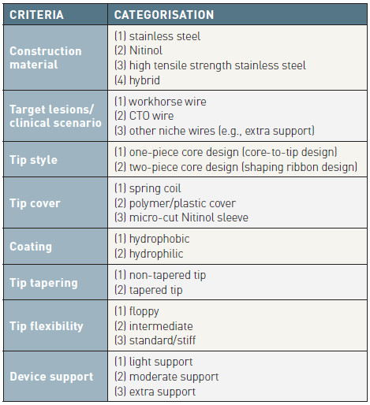

Guide catheters and wires
Table 14
Categorisation of guidewires
Soo-Teik Lim, Tian-Hai Koh
©2025 Europa Group - All rights reserved.

