Slide 1


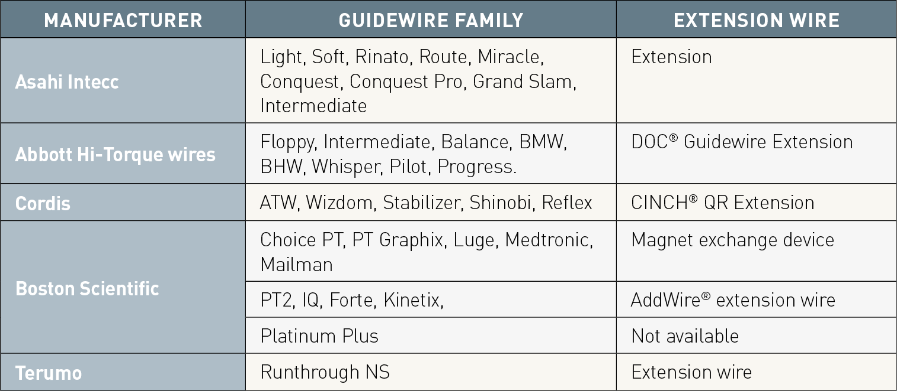

Guide catheters and wires
Table 16
Extension wire for lengthening the standard-length guidewire
Soo-Teik Lim, Tian-Hai Koh
©2025 Europa Group - All rights reserved.

