Slide 1


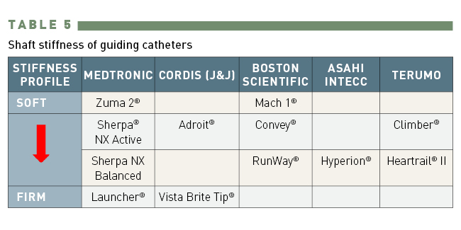

Guide catheters and wires
Table 5
Shaft stiffness of guide catheters
Soo-Teik Lim, Tian-Hai Koh
©2025 Europa Group - All rights reserved.

