Slide 1


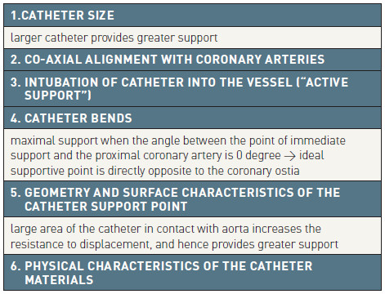

Guide catheters and wires
Table 6
Factors determining guide catheter support
Soo-Teik Lim, Tian-Hai Koh
©2025 Europa Group - All rights reserved.

