Slide 1


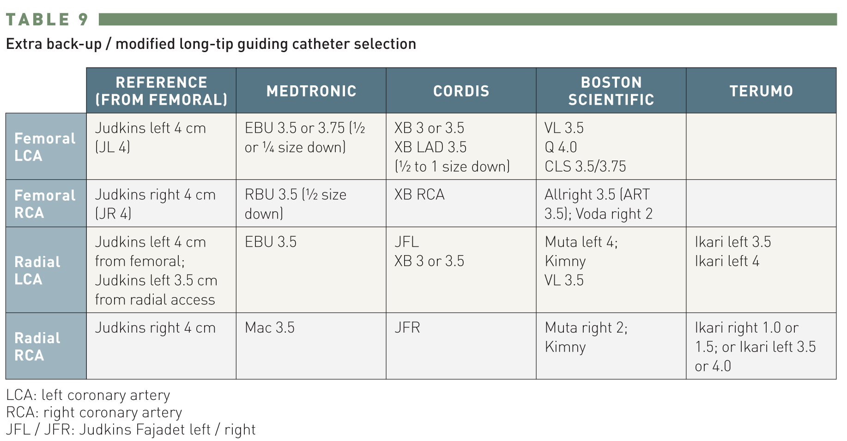

Guide catheters and wires
Table 9
Extra back-up/modified long-tip guide catheter selectionLCA -- left coronary arteryRCA -- right coronary arteryJFL / JFR -- Judkins Fajadet left / right
Soo-Teik Lim, Tian-Hai Koh
©2025 Europa Group - All rights reserved.

