Slide 1


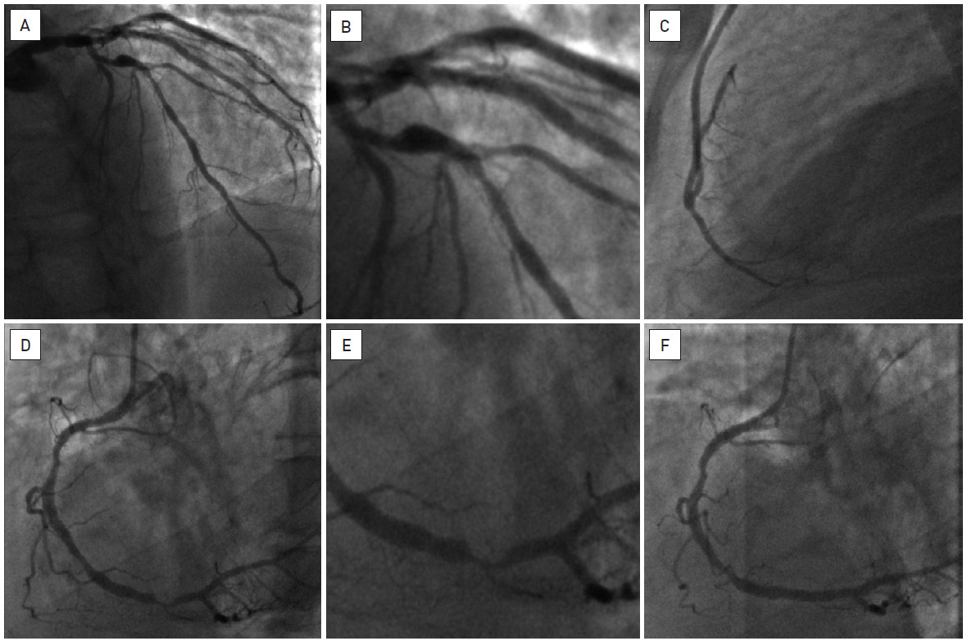

Hybrid interventions
Figure 1
FFR-guided complete hybrid revascularisation in a case of multivessel diseaseA forty-nine year old man, with previous stenting in the LAD and the LCx, presented with stable angina, Canadian Cardiovascular Society (CCS) class 2. Coronary angiography showed a diffusely diseased LAD (A) with severe in-stent re-stenosis (FFR 0.68) (B); the ostial lesion of the D1 was haemodynamically non-significant (FFR 0.95); there was also a significant (FFR 0.74) lesion of the distal RCA (D, E) while the LCx, although with diffuse atheromatosis, had no significant stenosis (FFR 0.84).The hybrid therapy consisted in a MIDCAB procedure with LIMA on the LAD (C) followed after one week by PCI and stenting (DES) of the distal RCA (F). The patient had an uneventful clinical evolution and was free of symptoms 6 weeks later.
Oana Bodea, Frank Van Praet, Hugo Vanermen, Philippe Kolh, Bernard de Bruyne
©2025 Europa Group - All rights reserved.

