Slide 1


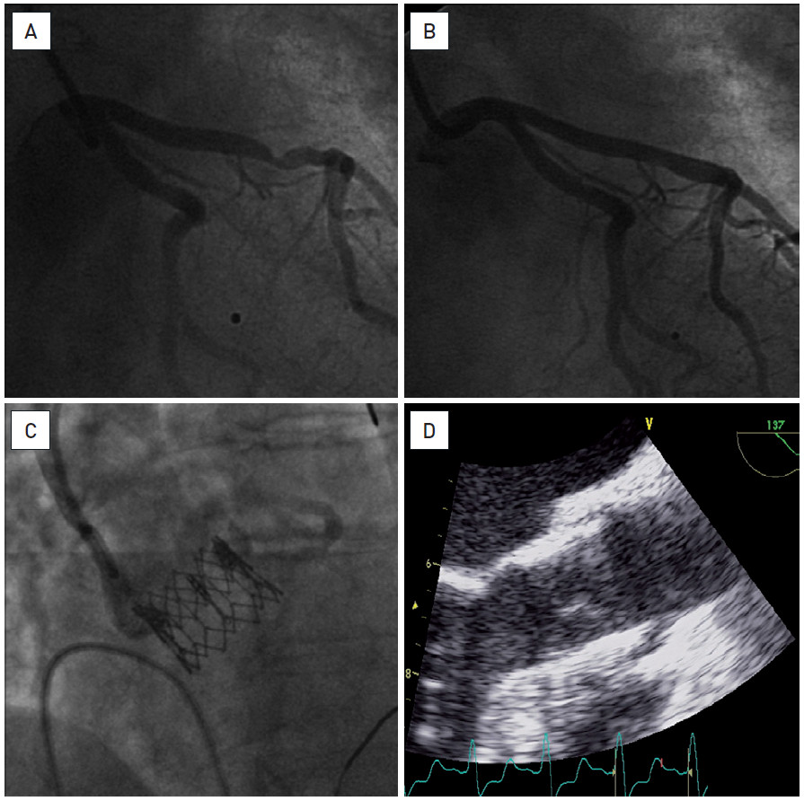

Hybrid interventions
Figure 2
Combined PCI and trans-femoral TAVIAn eighty-eight year old woman admitted for complaints of angina (CCS 3) as well as increasing dyspnoea on exertion, New York Heart Association (NYHA) class 3. A critical aortic stenosis (mean gradient of 56 mmHg, calculated aortic valve area (AVA) of 0.5 cm²) was associated with one-vessel coronary artery disease (significant lesion of the mid-LAD) (A). Six weeks after PCI with stenting (DES) of mid-LAD (B), a TAVI procedure was successfully performed via the trans-femoral approach (26 mm Edwards SAPIEN™ transcatheter heart valve (THV)) (C, D). She had a good early and late post-procedural evolution. At one year follow-up the patient was in NYHA class 1, without angina. The aortic prosthesis had a normal function.
Oana Bodea, Frank Van Praet, Hugo Vanermen, Philippe Kolh, Bernard de Bruyne
©2025 Europa Group - All rights reserved.

