Slide 1


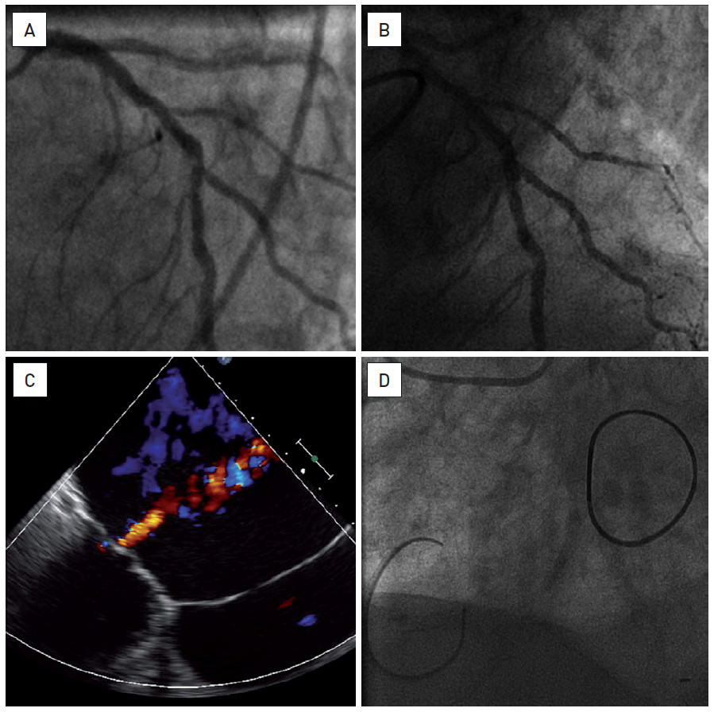

Hybrid interventions
Figure 3
Combined endoscopic valvular surgery and PCIAn eighty-three year old man referred for persistent symptoms of heart failure, NYHA class 3. The patient had severe MR, 3+/4 with massively dilated left atrium (more than 10 cm) (C), preserved LVEF and associated severe pulmonary hypertension. Coronary angiography showed a diffuse atherosclerosis with a short, calcified and haemodynamically significant (FFR 0.68) lesion of LAD at the bifurcation with D1 (A). The patient underwent an endoscopic MVP and tricuspid valvuloplasty (TVP) (D), followed, ten days later, by a PCI (DES) of the LAD (B). The clinical evolution was slow but favourable without major complications and he was discharged on day 12.
Oana Bodea, Frank Van Praet, Hugo Vanermen, Philippe Kolh, Bernard de Bruyne
©2025 Europa Group - All rights reserved.

