Slide 1


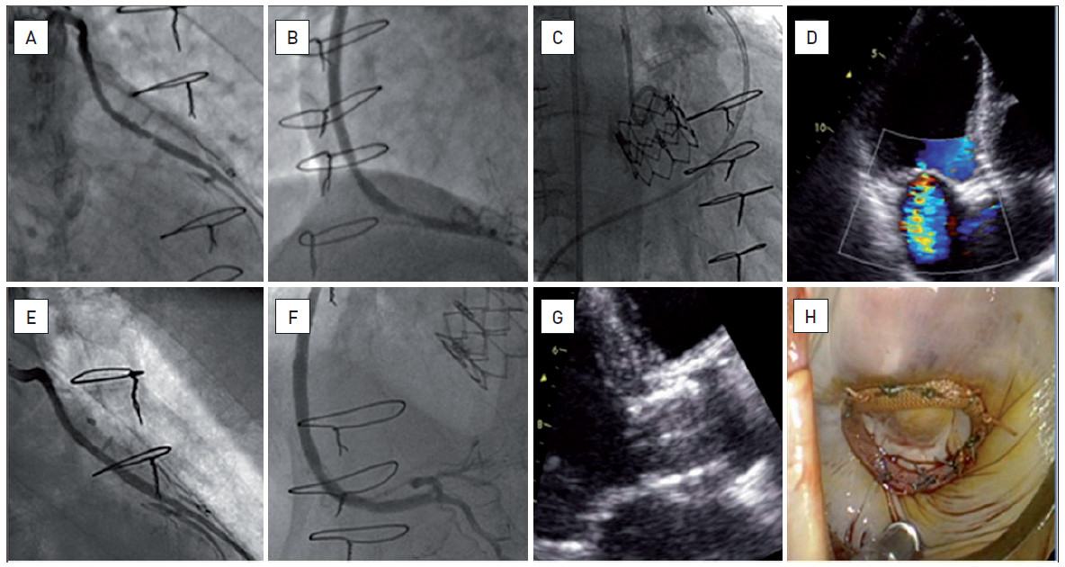

Hybrid interventions
Figure 4
Staged hybrid approach combining PCI, trans-femoral TAVI and endoscopic mitral valve surgeryA seventy-five year old man with a long and complex history of coronary artery disease (re-do CABG followed by multiple, recurrent PCIs of the native vessels as well as of the grafts), symptomatic with effort angina and progressively increasing dyspnoea with episodes of acute pulmonary oedema. The presence of bi-valvular disease (severe aortic stenosis, mean gradient 52mmHg, estimated AVA of 0.72cm²; moderate/severe MR, 2-3/4) associated with new and haemodynamically significant lesions of the venous grafts (A, B) led our Heart Team advise a staged hybrid approach: PCI (E, F), followed by a trans-femoral TAVI procedure with implantation of a 26mm Edwards SAPIEN THV (C, G) and then by an endoscopic MVP (D, H). All interventions were completed with excellent functional results.
Oana Bodea, Frank Van Praet, Hugo Vanermen, Philippe Kolh, Bernard de Bruyne
©2025 Europa Group - All rights reserved.

