Slide 1


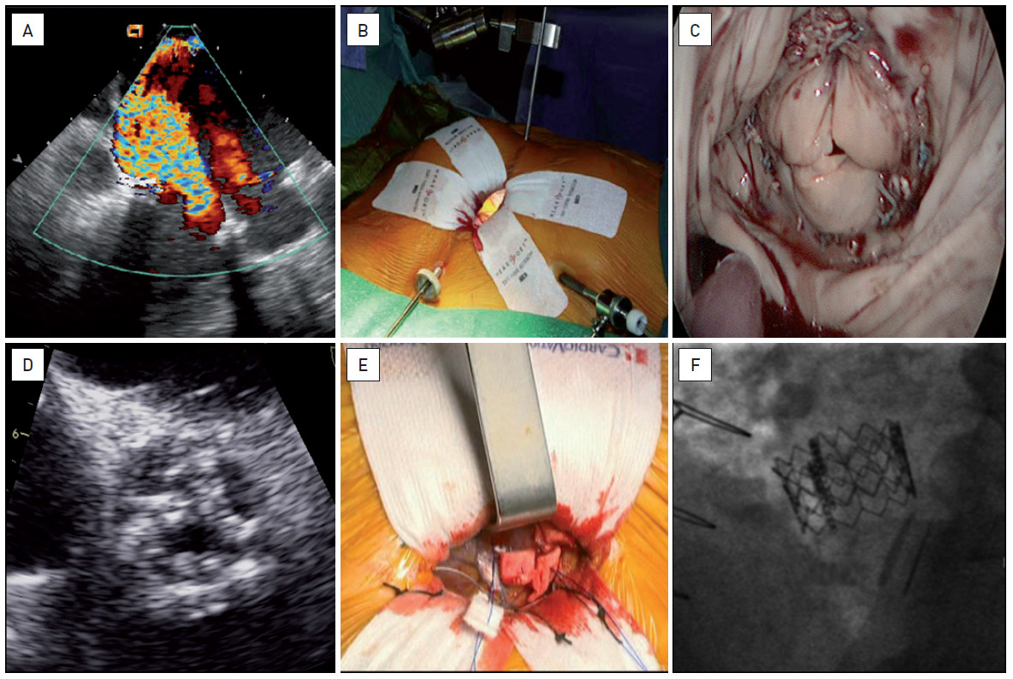

Hybrid interventions
Figure 5
Simultaneous trans-apical TAVI and minimally invasive mitral and tricuspid valve surgeryA seventy-seven year old woman with a history of previous cardiac surgery (MVR, TVP and supra-coronary replacement of the ascending aorta) was admitted for persistent symptoms of heart failure, NYHA class 3-4. She presented with complex valvular disease including massive MR (as result of degenerative changes of the mitral bioprosthesis) (A, C), severe TR and low-output low-gradient, though severe, aortic stenosis (D). With multiple comorbidities and a logistic EuroSCORE of 50%, she was referred for hybrid minimally invasive surgery with simultaneous endoscopic MVR/TVP (B) and trans-apical TAVI (E). The clinical evolution was favourable with discharge at day 15. The function of both valves (F) was normal.
Oana Bodea, Frank Van Praet, Hugo Vanermen, Philippe Kolh, Bernard de Bruyne
©2025 Europa Group - All rights reserved.

