Slide 1


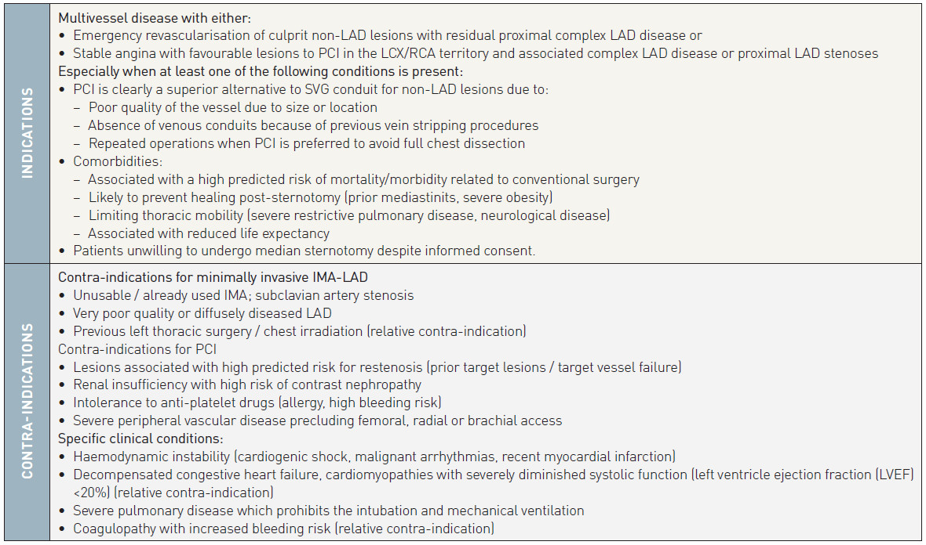
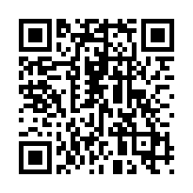
Hybrid interventions
Table 1
Indications and contra-indications for hybrid myocardial revascularisation
Oana Bodea, Frank Van Praet, Hugo Vanermen, Philippe Kolh, Bernard de Bruyne
©2025 Europa Group - All rights reserved.

