Slide 1


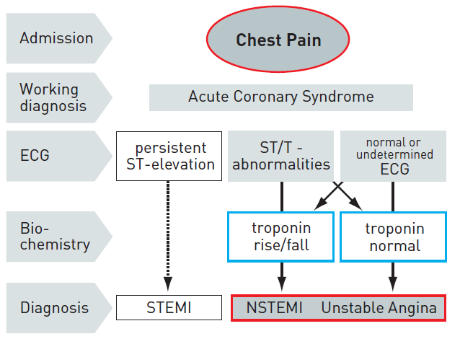
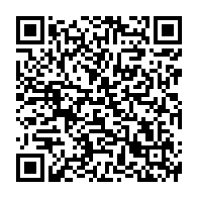
Interventions for non-ST-segment elevation acute coronary syndromes
Figure 1
The spectrum of ACSECG: electrocardiogram; NSTEMI : non-ST-elevation myocardial infarction; STEMI : ST-elevation myocardial infarction.
Helge Möllmann, Holger M. Nef, Christian W. Hamm, Johannes Blumenstein
©2025 Europa Group - All rights reserved.

