Slide 1


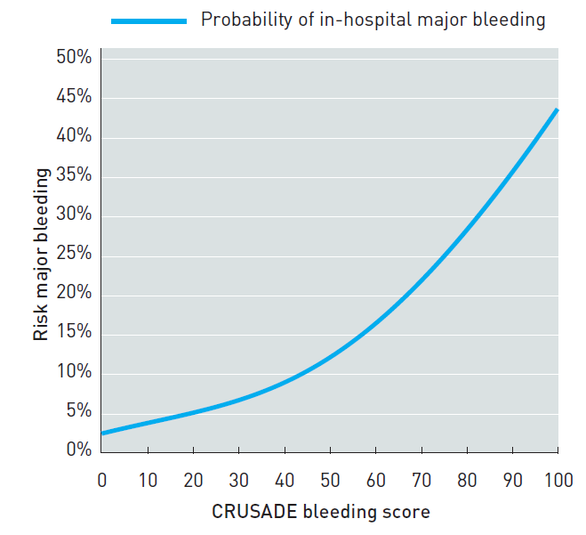
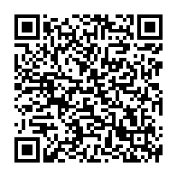
Interventions for non-ST-segment elevation acute coronary syndromes
Figure 2
Risk of major bleeding across the spectrum of CRUSADE bleeding score (www.crusadebleedingscore.org/)
Helge Möllmann, Holger M. Nef, Christian W. Hamm, Johannes Blumenstein
©2025 Europa Group - All rights reserved.

