Slide 1


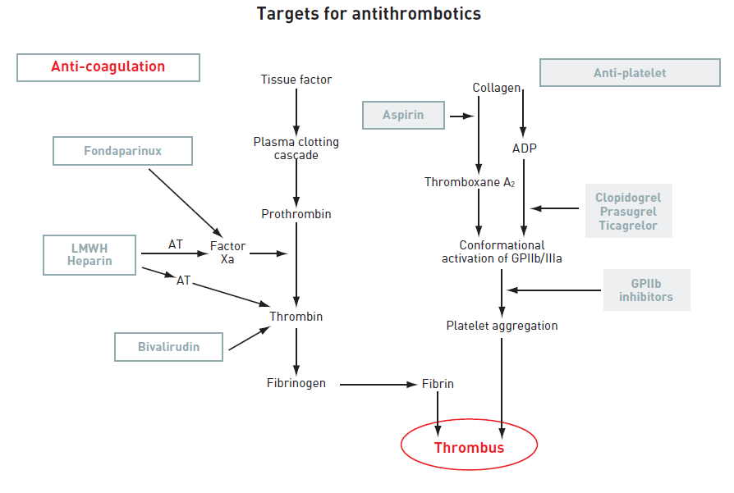
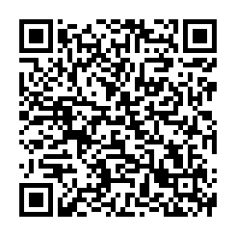
Interventions for non-ST-segment elevation acute coronary syndromes
Figure 3
Targets for antithrombotic drugsADP: adenosine diphosphate; AT: antithrombin; GP: glycoprotein; LMWH: low-molecular-weight heparin; TRA: thrombin receptor antagonist.
Helge Möllmann, Holger M. Nef, Christian W. Hamm, Johannes Blumenstein
©2025 Europa Group - All rights reserved.

