Slide 1


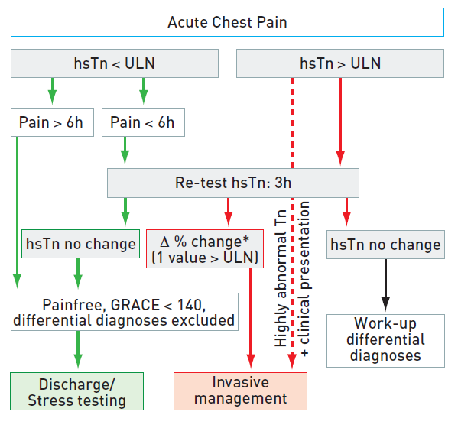
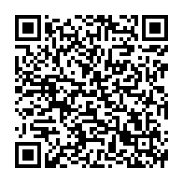
Interventions for non-ST-segment elevation acute coronary syndromes
Figure 4a
Rapid rule out of ACS with high sensitive troponinhsTn: high sensitivity troponin.ULN: upper limit of normal, 99th percentile of healthy controls.*Δ% change, dependent on assay.
Helge Möllmann, Holger M. Nef, Christian W. Hamm, Johannes Blumenstein
©2025 Europa Group - All rights reserved.

