Slide 1


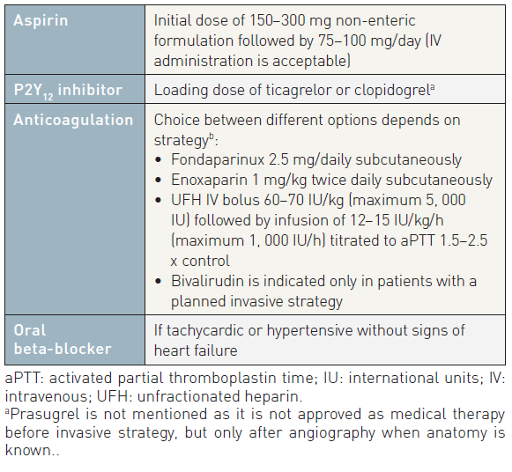
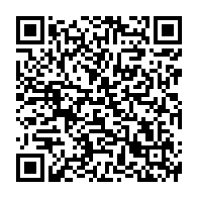
Interventions for non-ST-segment elevation acute coronary syndromes
Table 11A
Checklist of treatments when an ACS diagnosis appears likely
Helge Möllmann, Holger M. Nef, Christian W. Hamm, Johannes Blumenstein
©2025 Europa Group - All rights reserved.

