Slide 1


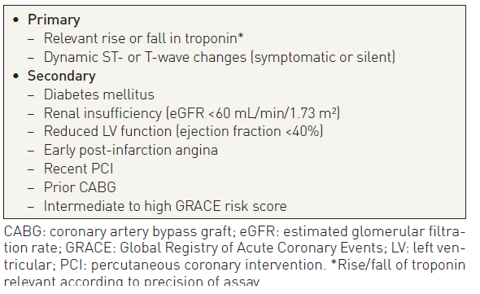

Interventions for non-ST-segment elevation acute coronary syndromes
Table 8
Criteria for high risk with indication for invasive management
Helge Möllmann, Holger M. Nef, Christian W. Hamm, Johannes Blumenstein
©2025 Europa Group - All rights reserved.

